Slide 1
TITANIC DATA ANALYSIS

Slide 2
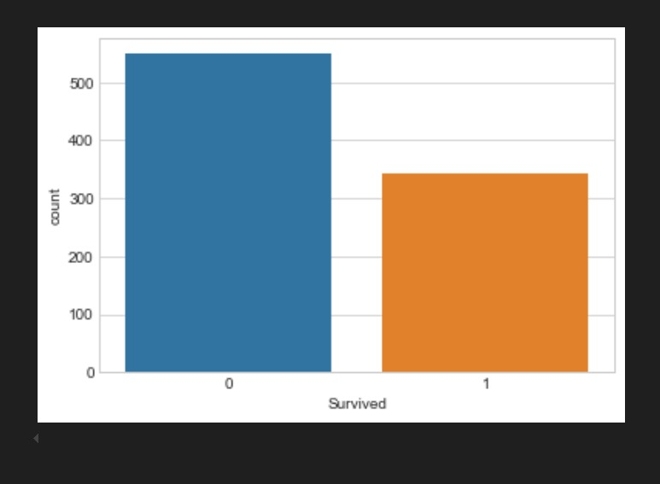
Survived Count
The bar chart above displays the number of passengers who survived and did not survive on the Titanic, based on the Survived column from the dataset:
The x-axis represents the survival status:
0 = Passenger did not survive
1 = Passenger survived
The y-axis shows the number of passengers in each category.
From the graph:
The bar corresponding to 0 (did not survive) is significantly taller, indicating that more passengers died.
The bar for 1 (survived) is shorter, showing fewer passengers survived.
This visual highlights the overall mortality rate on the Titanic—more people perished than survived.

Slide 3
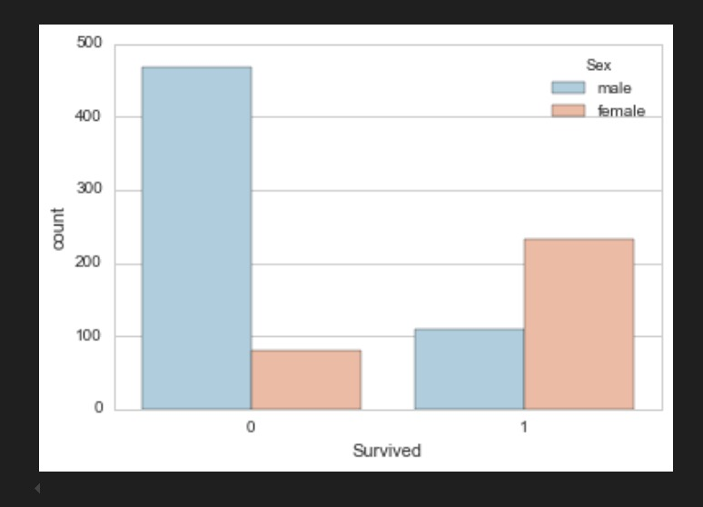
Survived in Sex
This graph shows the number of male and female passengers who survived (1) and who did not survive (0).
Male Passengers:
A very high count of males did not survive.
Much fewer males survived compared to those who died.
Female Passengers:
Relatively few females died.
Most females survived, as shown by the tall bar in the Survived = 1 category.

Slide 4
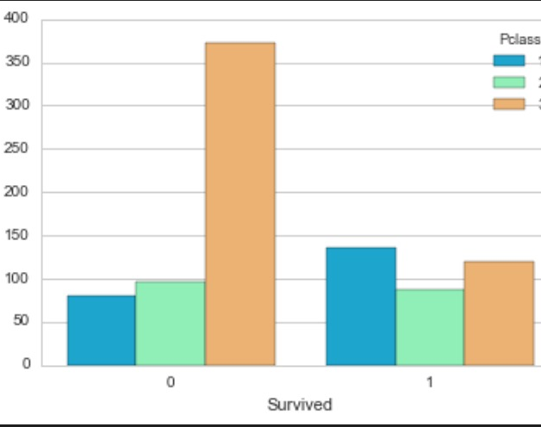
Survived in Pclass
This bar chart shows how survival varied by passenger class:
For Survived = 0 (Did Not Survive):
The tallest bar is for 3rd class → Most of the people who died were in 3rd class.
2nd class and 1st class passengers had fewer deaths compared to 3rd class.
For Survived = 1 (Survived):
The 1st class passengers had the highest survival count.
2nd class passengers also survived, but fewer than 1st class.
Fewer 3rd class passengers survived in comparison.

Slide 5
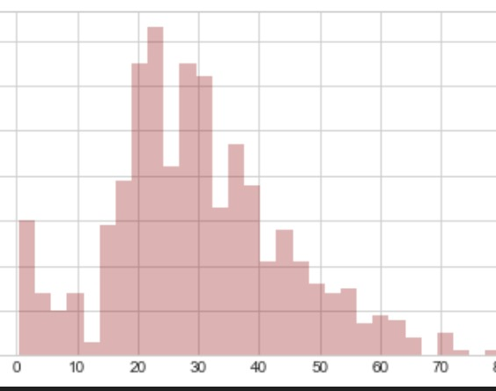
Survived in Age
This histogram shows how passengers were distributed by age on the Titanic.
The x-axis represents passenger age (from 0 to about 80).
The y-axis shows the number of passengers in each age group.

Slide 6
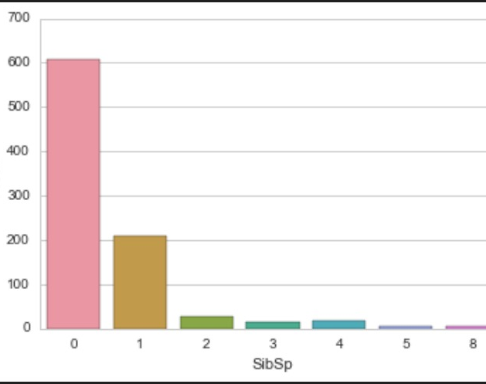
Survived in SibSp
This bar chart shows how many passengers had siblings or spouses on board, and how common each case was.
The x-axis is SibSp – number of siblings/spouses a passenger had on board. Values range from 0 to 8.
The y-axis is the number of passengers (count) for each of those values.

Slide 7
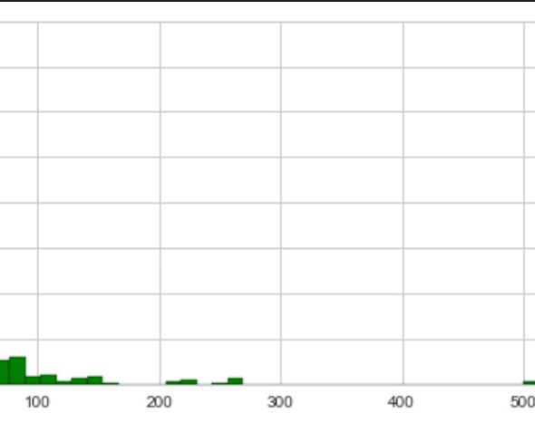
Survived in Fare
This histogram visualizes how passenger fares were distributed.
The x-axis shows the fare values (ticket price).
The y-axis shows how many passengers paid fares in each range.

Slide 8
THE END

